Slide 1

Caring for American Indian and Alaska Native children and adolescents, an update on the American Academy of Pediatrics Policy Statement
Shaquita Bell, MD, FAAP
Clinical Professor, Pediatrics, University of Washington
Seattle Children’s Hospital

Slide 2
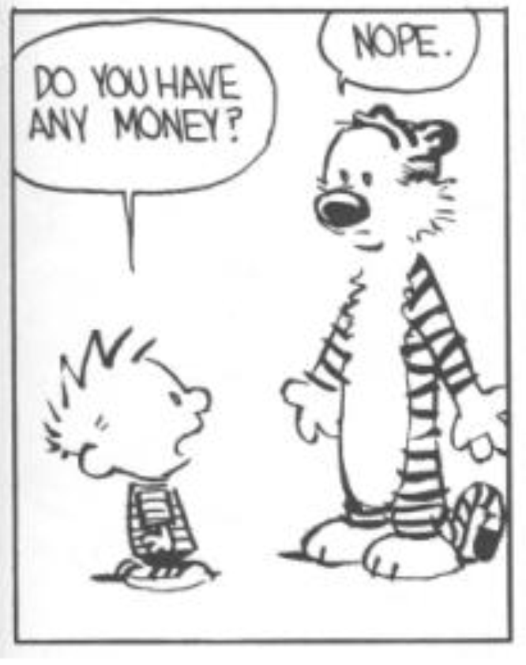
Disclosure
Neither I nor any member of my immediate family has a financial relationship or interest with any proprietary entity producing health care goods or services related to the content of this CME activity.
My content will not include discussion/reference of any commercial products or services.
I do not intend to discuss an unapproved/investigative use of commercial products/devices
Notes:
I do not have any financial interest in violence

Slide 3
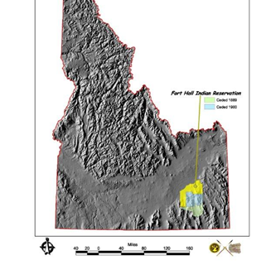

Notes:
Shoshone-Bannock Tribes are organized under the 1934 Indian Reorganization Act, and they operate under a constitution approved on April 30, 1936

Slide 4
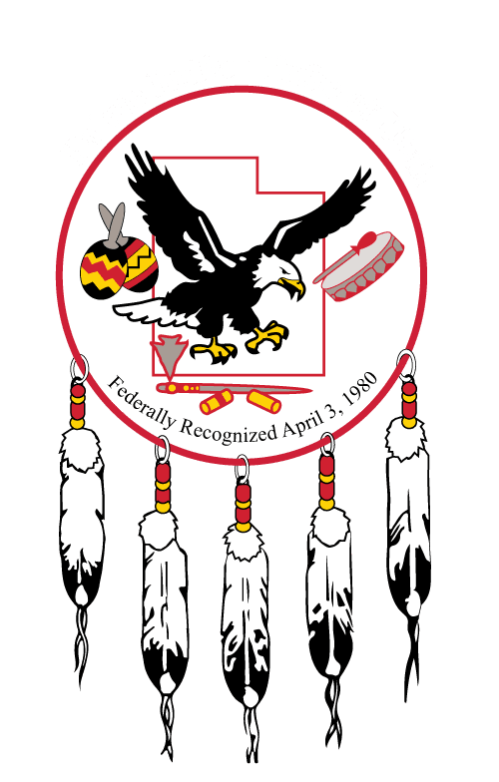
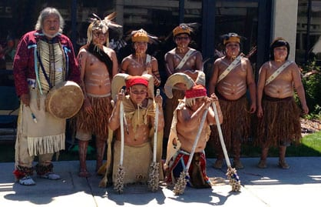
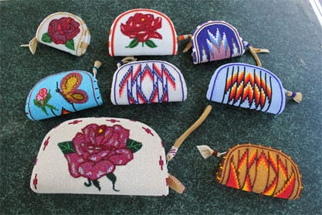
Paiute
Notes:
In 1954 the Utah Paiutes were wrongfully subject to the Termination Act, which terminated the Paiutes federal recognition and Federal trust responsibility

Slide 5
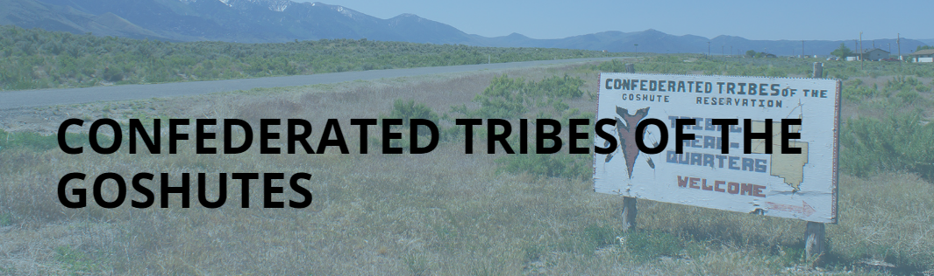
Notes:
The Confederated Tribes of Goshute is one of the two bands of the Goshute Nation, the other being the Skull Valley Band. They are located southeast of Wendover, near the Deep Creek Mountains, and their 112,870 acre reservation, the Deep Creek Reservation, is in White Pine County, Nevada, and Juab and Tooele counties in Utah
White settlement began in the 1850s with the arrival of the Mormons, leading to conflict and federal government efforts to remove the Goshute Indians. They failed in their attempts and it was not until 1914 that the Deep Creek Reservation was formed. Although this ensured the Goshute ownership of their own land, their way of life was changed when federal agents promoted agriculture, a large change from their usual efficient use of wild plants.
The harsh desert land could not support this change, and since then the Goshute have turned to other sources of economic opportunity. Currently, the Goshute of the Deep Creek Reservation manage an elk herd, where they profit from hunting permits

Slide 6
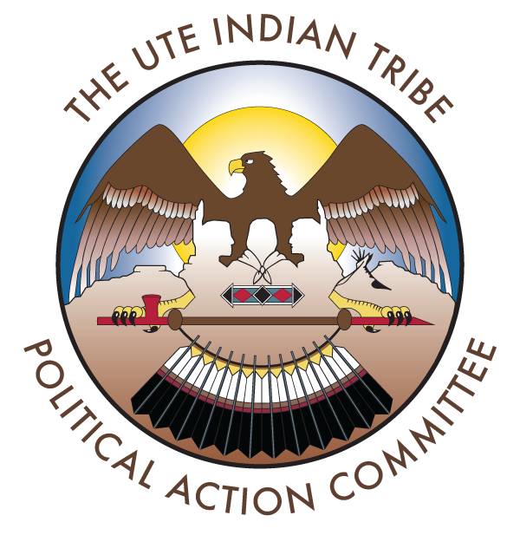
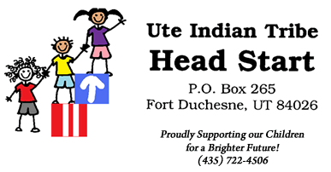
Notes:
The Uintah and Ouray reservation is located in Northeastern Utah (Fort Duchesne) approximately 150 miles east of Salt Lake City, Utah on US Highway 40. The reservation is located within a three-county area known as the "Uintah Basin". It is the second largest Indian Reservation in the United States and covers over 4.5 million acres.

Slide 7
Notes:
Authors, land rec, centering

Slide 8
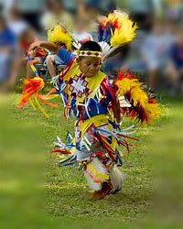
Adverse Childhood Experiences
Obesity
Breastfeeding
Children and Youth with Special Health Care Needs
Suicide and Mental Health
Health and Identity
Violence
Foster Care
Governmental and Political Influences

Slide 9
Adverse childhood experiences

Slide 10
American Journal of Preventive Medicine. 1998, Volume 14, pages 245–258

Slide 11
Adverse childhood experiences
Physical abuse
Emotional abuse
Sexual abuse
Family substance abuse
Family mental illness
Incarcerated family member
Parental separation/divorce
Seeing mother physically abused
Physical neglect
Emotional neglect
ACE score = number of categories experienced before age 18

Slide 12
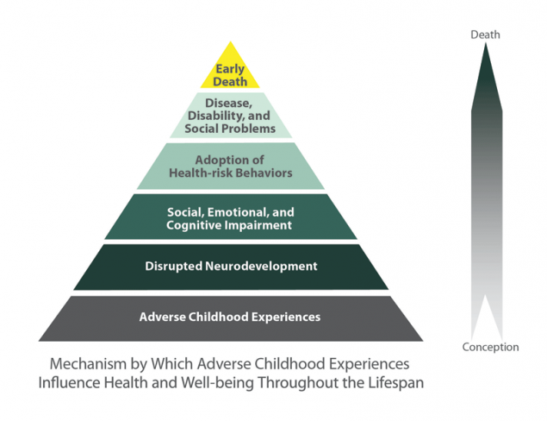
Notes:
Loss of culture and systemic racism also may be unique/specific ACEs

Slide 13
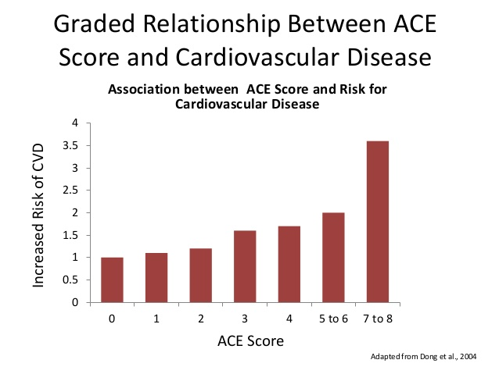
ACEs have long lasting effects . . .
Health (CVD, obesity, DMII, depression, cancer, STIs)
Behaviors (smoking, EtOH, drug use)
SES (graduation rates, academic achievement)
Notes:
Adults with >/= 3 ACEs are 2x more likely to smoke, 2x more likely to develop CVD and 1.5x as likely to become obese or have diabetes.

Slide 14
Obesity

Slide 15
Am J Hum Biol. 2012;24(3):302-314
Notes:
The CDC estimates the prevalence of overweight/obese AI youth at 58.8%.

Slide 16
Obesity (with subsequent development of glucose intolerance and HTN) was associated with premature endogenous mortality
N Engl J Med. 2010;362:485-493

Slide 17
Inequities in metabolic syndrome
Metabolic syndrome prevalence in adolescents
  American Indians – 24.9%
  Mexican-Americans – 12.9%
  Non-Hispanic Whites – 10.9%
  African Americans – 2.5%
  J Am Coll Cardiol. 2008;52:932-8
  Circulation. 2004;110:2494-7
MetS increases CVD incidence x 2 and DMII incidence x 5
  J Am Coll Cardiol.2010;56:1113-32

Slide 18
471 AI children from Wisconsin, aged 5-8
47% were overweight or obese
BMI largely determined by age 1
Matern Child Health J. 2012;16:1879-86

Slide 19
Breastfeeding

Slide 20
Although AI/AN women have the second-lowest prevalence of breastfeeding initiation, those who did so for 6 months, tended to continue through infancy.
Furthermore, a lower BMI was observed in AI adolescents who were breastfed for >6 months
J Acad Nutr Diet. 2017;117:1049-1056.

Slide 21
Children and Youth with Special Health Care Needs

Slide 22
AI/AN children do not have a higher prevalence of special health care needs as compared to other children, however they are more likely to have functional difficulties and likely more disability*
  *due to injury, inadequate prenatal care, preterm birth or environmental stressors

Slide 23
All children with special health care needs benefit from a coordinated, comprehensive medical home, but AI/AN children have barriers* receiving medical-home based primary care, subspeciality care or outpatient rehabilitation
  *may be due to transportation, funding, wait times, cultural insensitivity

Slide 24
Mental Health

Slide 25
Suicide is the second-leading cause of death for all youth aged 10 to 24 years
Mortality is 1.5x higher for AI/AN youth
There is intertribal variation in AI/AN suicide mortality
ACEs increase lifetime suicide attempt in AI/AN youth
37% increase in attempts with each ACE point
American Journal of Public Health | Supplement 3, 2014, Vol 104, No. S3

Slide 26
Effective suicide prevention initiatives are strengths based, community driven, and culturally centered
  Cultural protective factors should be prioritized
  School-based health care centers can be used as an adjunct to other mental heath services
Prev Sci. 2018 February ; 19(2): 174–185.

Slide 27
Health and Identity

Slide 28
Two-Spirit AI/AN youth experience significant health inequities
  Transgender AI/AN individuals experience harassment (86%), physical assault (51%) and sexual assault (21%)
  Fifty seven percent of AI/AN transgender youth have contemplated suicide (versus 33.7% of all transgender youth)
  Twenty three percent of AI/AN transgender youth experience joblessness
J Racial Ethn Health Disparities. 2020; 7(4):630–642

Slide 29
Violence

Slide 30
More AI/AN youth experience significant injury from trauma (11.8% versus 4.1% of white children)
#MMIW – AI/AN girls experience staggering rates of violence
J Racial Ethn Health Disparities.2019;6(2):335–344

Slide 31
Thirty percent of AI girls (11 – 17 years) report sexual abuse and 11% have been raped
AN women and girls represent 33% of the sex trafficking victims despite comprising 8% of the Alaska population
AI/AN girls are 5x more likely to be arrested for prostitution compared to white girls

Slide 32
Foster care

Slide 33
AI/AN youth are referred for child protection services more often than other children
Those AI/AN children in foster care are more likely to have special health care needs
Child Welfare. 2012;91(4):61–84

Slide 34
Governmental and political influences

Slide 35
Governmental and political influences
Health care delivery to AI/ANs influenced by governmental policy at the federal, state and tribal level
Treaties established a trust relationship between tribal nations and the federal government
Treaty-based health care system is organized within the Indian Health Service
Failure to honor these treaties shape mistrust among AI/AN communities

Slide 36
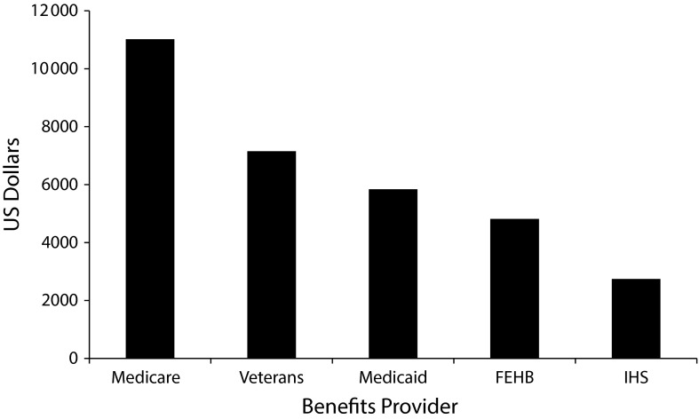
2011-2019 Indian health expenditures per capita compared with other federal health care expenditures per capita
IHS uses 12 area offices to operate 170 IHS and tribal run service unites. 41 urban Indian health programs
FY 2020: $6.0 billion

Slide 37
Medicaid access
Many AI/AN children receive health care services outside of the IHS
Some >300,000 AI/AN children and adolescents are covered by Medicaid
Medicaid payment rates directly tied to the likelihood of practices accepting Medicaid patients

Slide 38
AI/AN community's experience overenforcement of punitive drug laws; many target pregnant women
This in turn may limit prenatal care
Conflicting tribal versus state and federal laws → lack of standard universal screening policies for pregnant AI/AN women leading to late or inadequate detection of infants with a history of in utero substance exposure

Slide 39
Other health disparities
Poor oral health status of AI/AN children remains a major public health concern
AI/AN children and adolescents experience disproportionate rates of chronic otitis media and asthma

Slide 40
Recommendations

Slide 41
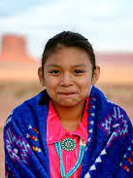
Partner with local tribes and communities to set health priorities, understand historical experiences, and combine efforts already underway, such as cultural enrichment and preservation programs
Provide evidence-based supports for parents and young children by promoting the use of home visiting models, high-quality child care, and early childhood programs, such as Early Head Start, Head Start, and Nurse-Family Partnership

Slide 42
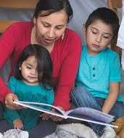
Start a Reach Out and Read program in AI/AN clinics and any clinic serving these families. Include books representing AI/AN and Indigenous children and families
Assess patients for ACEs and social determinants of health
Identify strengths and screen youth and families for protective factors to promote positive youth development
Create efforts to promote and strengthen protective factors for youth, focusing on cultural preservation–based efforts

Slide 43
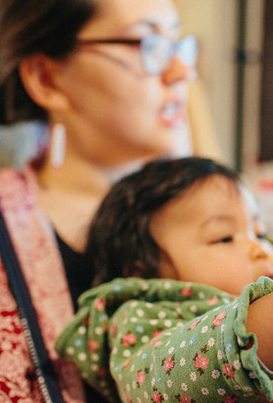
Consider testing for prediabetes and T2DM in AI/AN children and adolescents with overweight or obesity
Promote breastfeeding in AI/AN tribal communities, ideally coordinated by tribal entities and involving community members, elders, and health care providers, including paraprofessionals
Include early childhood oral health as part of overall childhood health and well-being

Slide 44
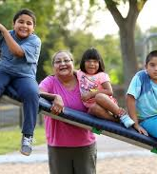
Create a medical home that acknowledges and is sensitive to discrimination in clinical settings and generations of unresolved traumas and racism that AI/AN children and families experience
Create a medical home model that facilitates access to services that will help AI/AN CYSHCN achieve their functional potential. Identify AI/AN CYSHCN, engaging staff, including care coordinators, in cultural competency training and partnering with the community

Slide 45
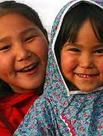
Screen AI/AN youth for substance use, and if identified, conduct a brief intervention and then refer for ongoing treatment
Work with local schools to identify AI/AN students in need of mental health and educational services
Offer gender-affirming care in line with the previously published American Academy of Pediatrics policy statement
Work to prevent, identify, and address sex trafficking in AI/AN youth

Slide 46
Public policy advocacy

Slide 47
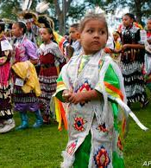
Advocate for community initiatives and develop partnerships to address health disparities, such as altering practices of frequent consumption of sugar-sweetened beverages through education and improving the selection of foods locally available, to address healthy weight and oral health
Share information with the US Congress, state legislatures, foundations, and other appropriate advocacy groups about the inequities and tremendous health disparities that exist between AI/ AN populations and the general US population

Slide 48
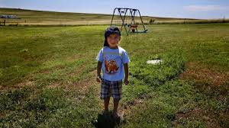
Invest in new research and clinical pathways to create culturally relevant screening and interventions for ACEs
Advocate for federal, state, and local policy to end AI/AN homelessness through consultation and engagement with tribal leaders, AI/AN communities, and AI/AN young people with lived experience of homelessness
Work with local tribes and communities to address the need for research and advocacy around missing and murdered Indigenous women and girls

Slide 49
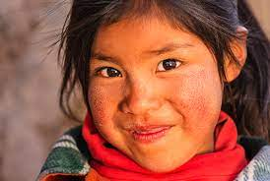
Advocate for increased Medicaid coverage for children and families as well as increased payment for services
Advocate for improved IHS budget and funding, and for policies such as advanced appropriations or mandatory funding to provide the IHS with predictable and continuous funding
Work with local government and tribal communities to understand and mitigate the negative effects of punitive drug laws for pregnant women

Slide 50
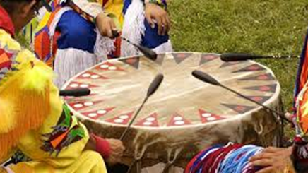
Thank you!
shaquita.bell@seattlechildrens.org

